Slide 1

1000 movies data Analysis
by Prabuddha Wanjare

Slide 2
Why we are talking about Movies ?
Why we watch movies ?
One of the answer is Feast of Vision which is Entertainment
As Entertainment is part of people’s lives, lets talk about movies because of which we always stay tuned to screens
Few of more reasons to watch movies is live in that fantasy world and releasing of emotions.
Learning, as through Visuals it is more effective
One of the reasons to choose this Dataset is that I work in Entertainment-Gaming industry, so field is relevant for me.

Slide 3
About Data
Data talks about 1000 rows of movies list and 12 columns.
Data is spread across different 20 unique genres, and over a decade(2006-2016).
Total 6 types of Numerical variables, and 5 categorical.
Few missing values are present in Metascore, and Revenue fields.

Slide 4
Research Questions
Movie Genres related:
Which genres are the most common (number of movies made)?
Which genres have high avg. Revenue? avg. Vote ? avg. Rating & Metascore ?
Which genres have high number of movies released?
Analysis of development of means of variables per genre over the years
How many movies are released per year ?
The distribution of revenue in different Rating levels in years.
The best movies according to vote avg. return high revenue ?
The best movies according to Ratings return high revenue ?
High metascore movies have a high vote avg. ?
High budget movies have a high ratings. ?

Slide 5
What I did ?
Data Wrangling & Cleaning:
Formatted the data in required framework using Pandas.
Identified the Null values and replaced them with mean.
One movie has multiple genres, Actors associated so split them for individual assessment
Plots and Charts:
Plotted Histograms, Bar-charts, Heat map, WordCloud against useful variables to derive results across research questions.

Slide 6
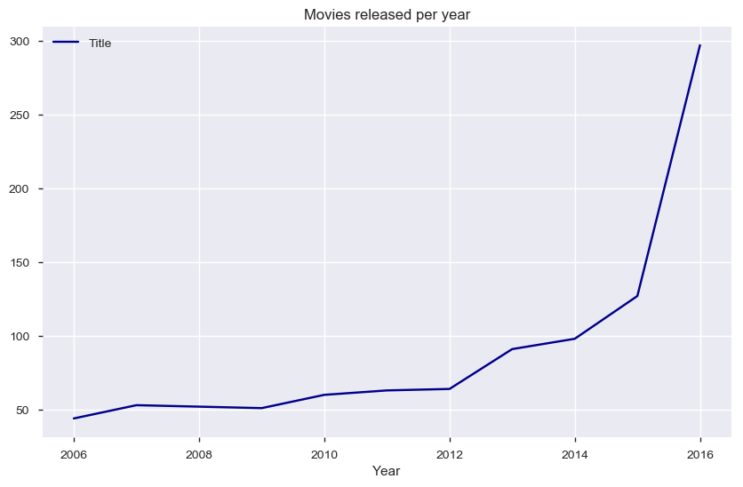
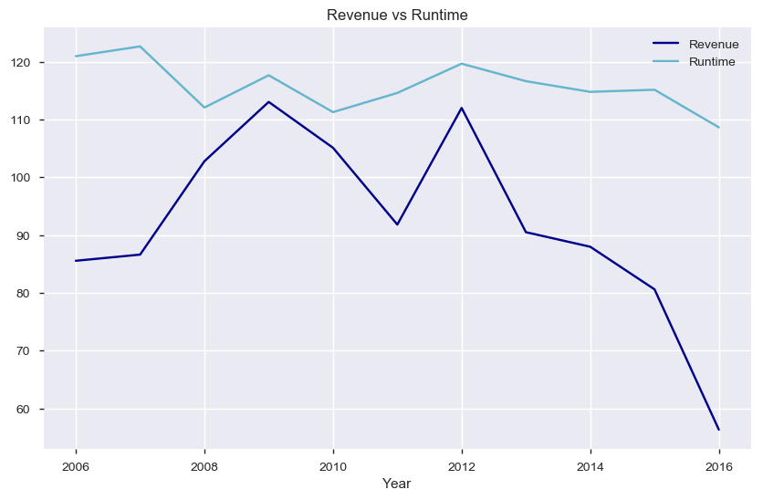
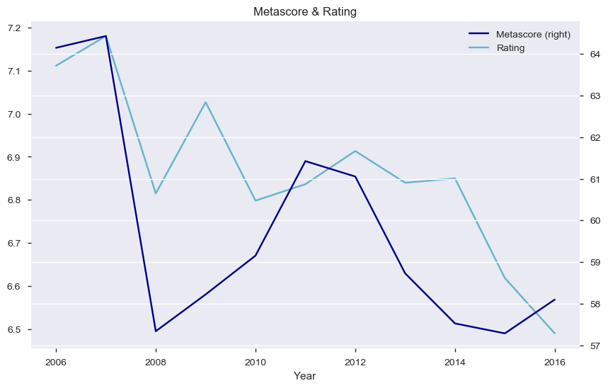
Movie Trends across Years

Slide 7
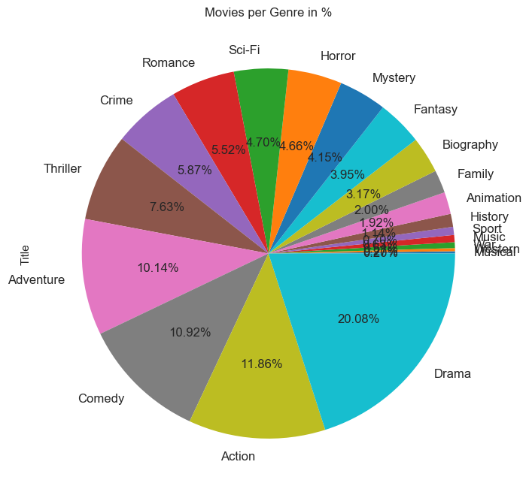
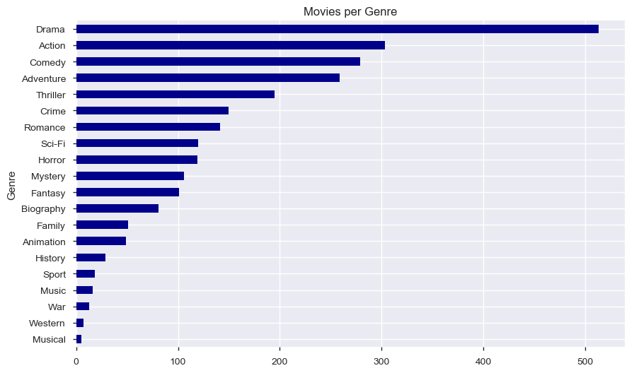
Movies Across Genres
From all above observations, we can conclude that most of with 513 Drama genre movies over the years are produced and it takes first place. Action with 12%(303) movies, Comedy with 11%(279) movies are at 2nd and 3rd place respectively.

Slide 8
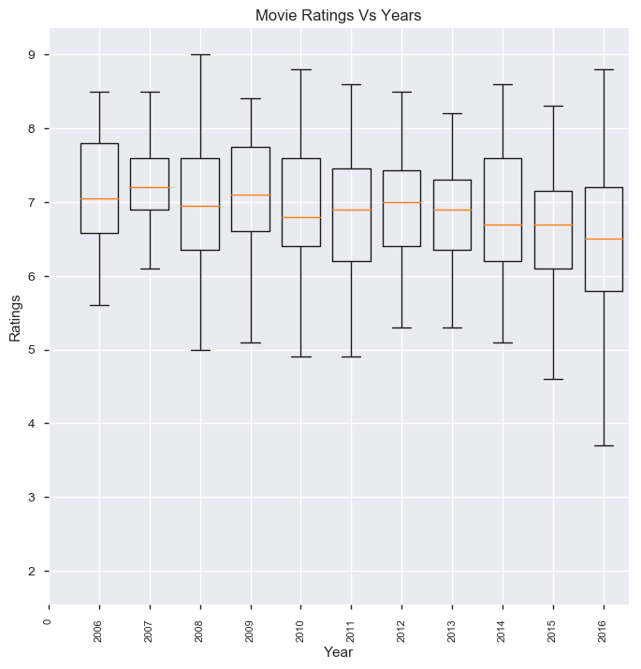
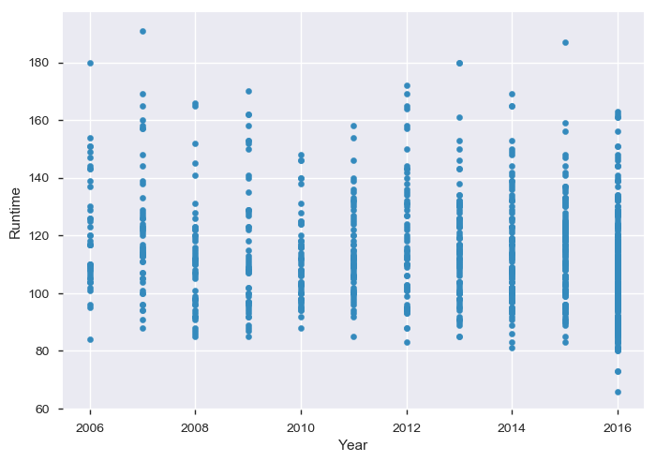
Ratings and Runtime across Years
Median of the Ratings of movies across years is decreasing In 2016 there was one movie which is very less comparted to any other years. Peak of one of the movies is around 195 minutes(3.15 hrs)

Slide 9
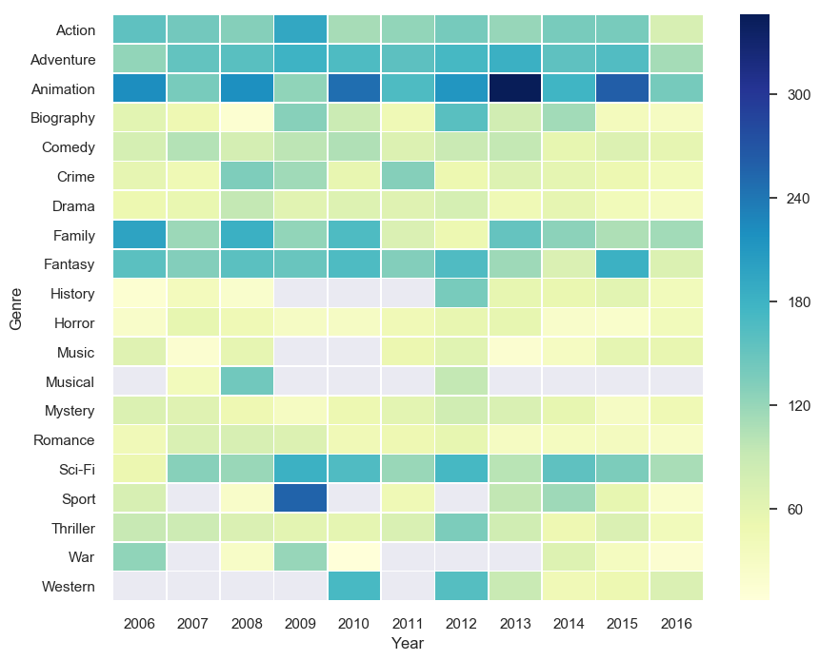
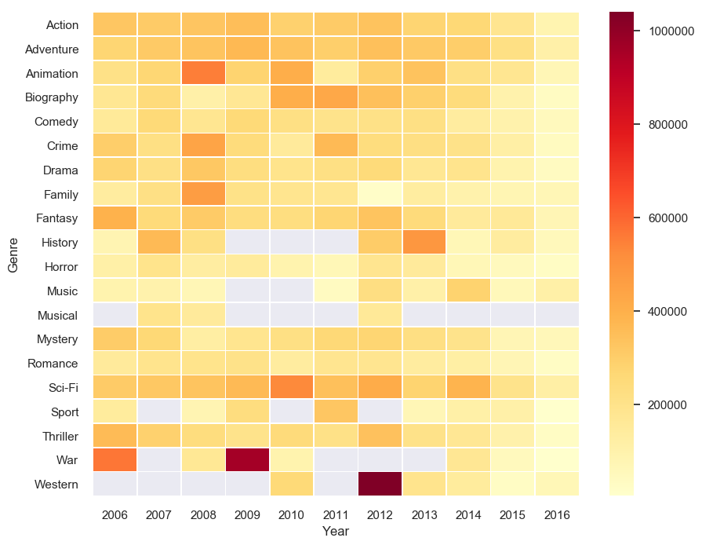
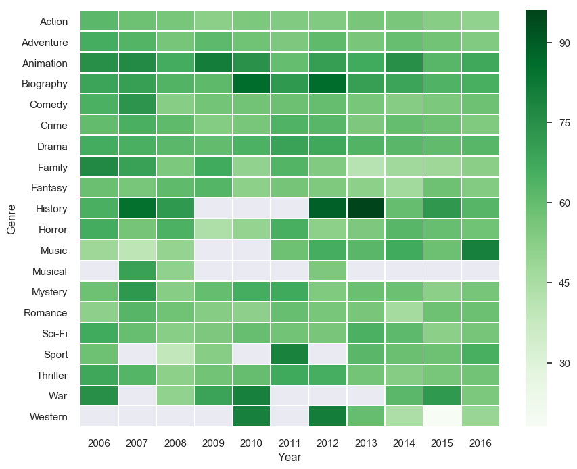
Revenue Distribution over Movie Genres
 | Heatmap distributions: Genres across Revenue: Animation movies had a very profitable year in 2013, 2015 and Sports in 2009. Genres across Votes: War and Western genre movies had most of votes in 2009 and 2012 Genres across Ratings: History genre movies are mostly rated for the year 2013.

Slide 10


Popular Directors and Actors
Most Famous Directors names are James, David, John, Chris and many more as per chart above | Most Famous names of the actors are Michael, David, John, Jessica and many more as per chart above

Slide 11
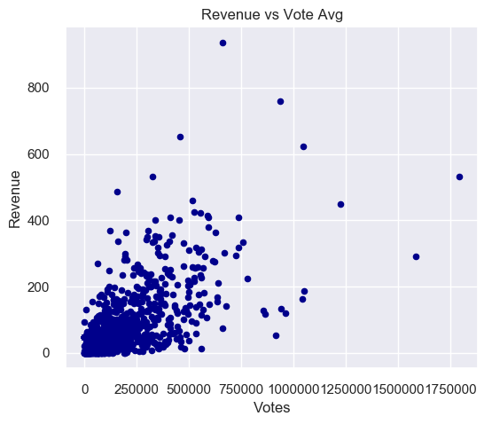
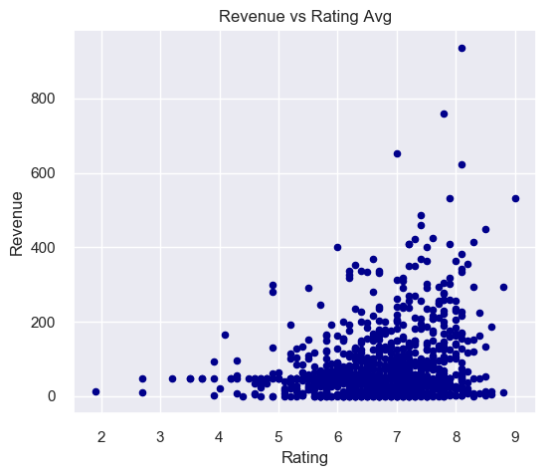
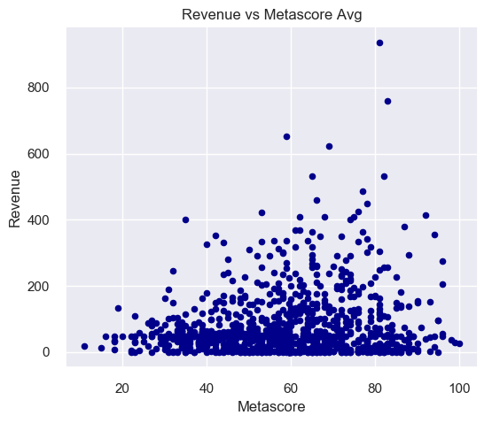
Revenue vs Other parameters
As per above chart, more ratings are clustered around 5-8 and revenue correlatively varied from 250-650 millions. More ratings lead to more Revenue trend can be seen in mentioned period As Votes will increase, there is might chance of increasing Revenue which is current trend says so. Metascore between 60-80 has maximum revenue scale apart from few outliers.

Slide 12
Conclusion
Over the years lot of movies were made and relatively Genres are also increased. Peak was between 2014 and 2016. Over the years, lot of Drama movies were released with total of more than 500 which is half of total comparison in sheet values. Hence if you want to opt for producing movie in future there are many references for you to check.
Though people vote more for Selective genres such as Sci-fi, Action, Adventure movies, but comparatively Animation Genre movies are earning more revenue. Hence CG is Future.
Over the years it is observed that Ratings and Metascore trend is decreasing. Hence people are giving rating less or voting less for getting proper result ? So Start voting for movies you watch
It is relative to say that if ratings and metascore are more then movie revenue is increasing. More the movies are for People, more the movies.

